Slide 1
Internet Forensics

Slide 2
Domain Name System (DNS)
How DNS Works?
DNS is a global system for translating IP addresses to human-readable domain names.
When a user tries to access a web address like “example.com”, their web browser or application performs a DNS Query against a DNS server, supplying the hostname.

Slide 3
Top level Domain(TLD)
A component called a DNS Resolver is responsible for checking if the hostname is available in local cache,
and if not, contacts a series of DNS Name Servers,
until eventually it receives the IP of the service the user is trying to reach, and returns it to the browser or application.
The root is managed by IANA
The DNS Root Server extracts the Top Level Domain (TLD) from the user’s query—for example, www.example.com—and provides details for the .com TLD Name Server. In turn, that server will provide details for domains with the .com DNS zone, including “example.com”.
There are different types of TLD name server. Initially this group consisted of GOV, EDU, COM, MIL, ORG, and NET.

Slide 4
DNS Record Types
DNS servers create a DNS record to provide important information about a domain or hostname, particularly its current IP address. The most common DNS record types are:
Address Mapping record (A Record)—also known as a DNS host record, stores a hostname and its corresponding IPv4 address.
IP Version 6 Address record (AAAA Record)—stores a hostname and its corresponding IPv6 address.
Canonical Name record (CNAME Record)—can be used to alias a hostname to another hostname. When a DNS client requests a record that contains a CNAME, which points to another hostname, the DNS resolution process is repeated with the new hostname.
Mail exchanger record (MX Record)—specifies an SMTP email server for the domain, used to route outgoing emails to an email server.
Name Server records (NS Record)—specifies that a DNS Zone, such as “example.com” is delegated to a specific Authoritative Name Server, and provides the address of the name server.
Reverse-lookup Pointer records (PTR Record)—allows a DNS resolver to provide an IP address and receive a hostname (reverse DNS lookup).
Start of Authority (SOA Record)—this record appears at the beginning of a DNS zone file, and indicates the Authoritative Name Server for the current DNS zone, contact details for the domain administrator, domain serial number, and information on how frequently DNS information for this zone should be refreshed

Slide 5
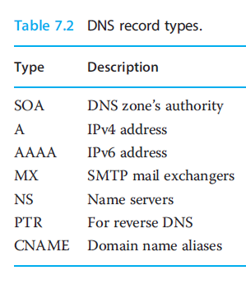
These lookups are cached for sometime determined by a value called time to live (TTL), saving network bandwidth, power ,and time

Slide 6
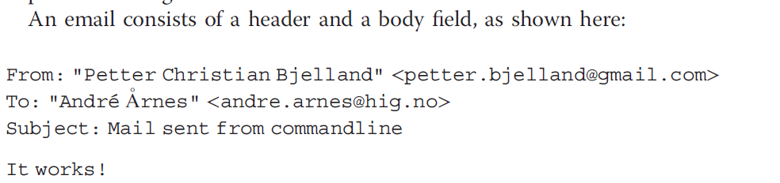
Email
Important protocols relating to the exchange of such data: the Simple Mail Transfer Protocol (SMTP), Internet Message Access Protocol (IMAP), and Post Office Protocol(POP).

Slide 7
SMTP is a widespread delivery-only protocol that pushes email from one mail server to another.
And while web mail services such as Gmail and Hotmail are using their own custom protocols for transmitting emails within their own networks (i.e.,sending email from one @gmail.com email address to another), they all use SMTP for sending emails outside their own network.
The recipients not disclosed in the email header are often referred to as BCC recipients (BCC stands for “blind carbon copy”).
The format supports attachments appended as Base64³ encoded text added as part of the email header.
Where as SMTP is a delivery-only protocol, the IMAP and POP protocols are used for managing user mail boxes and transmitting emails to the end user.

Slide 8
World Wide Web(WWW)
The World Wide Web, also known as the WWW and the Web, is an information space where documents and other web resources are identified by Uniform Resource Locators (URLs), interlinked by hypertext links, and accessible via the Internet.
Web resources are accessed using HTTP or HTTPS, which are application-level Internet protocols that use the Internet's transport protocols

Slide 9
http
HTTP is a protocol which allows the fetching of resources, such as HTML documents. It is the foundation of any data exchange on the Web and a client-server protocol
Clients and servers communicate by exchanging individual messages (as opposed to a stream of data).
The messages sent by the client, usually a Web browser, are called requests and the messages sent by the server as an answer are called responses.

Slide 10
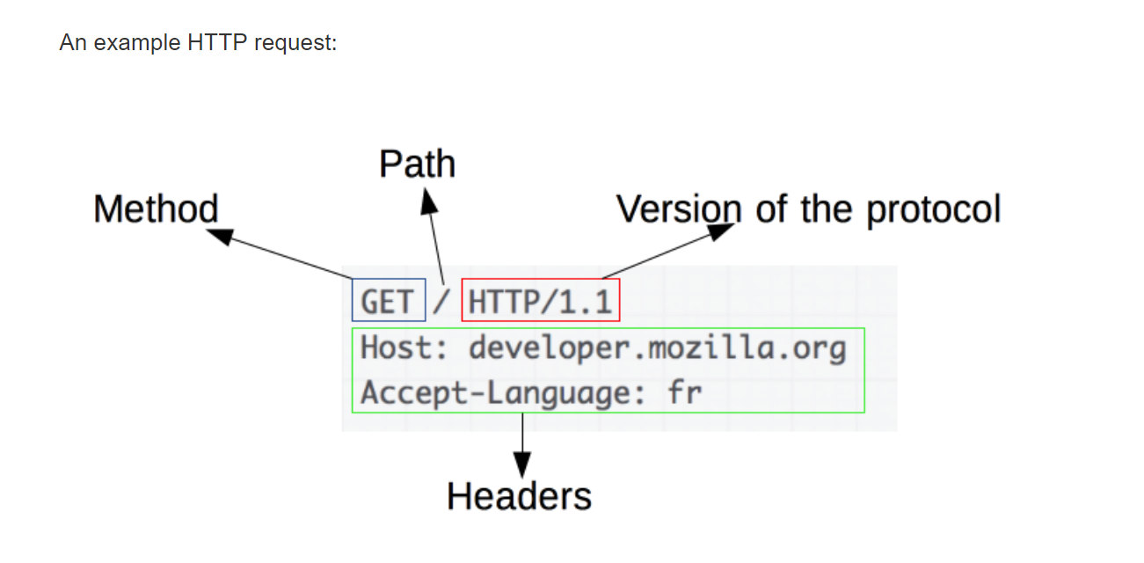
http request header:

Slide 11
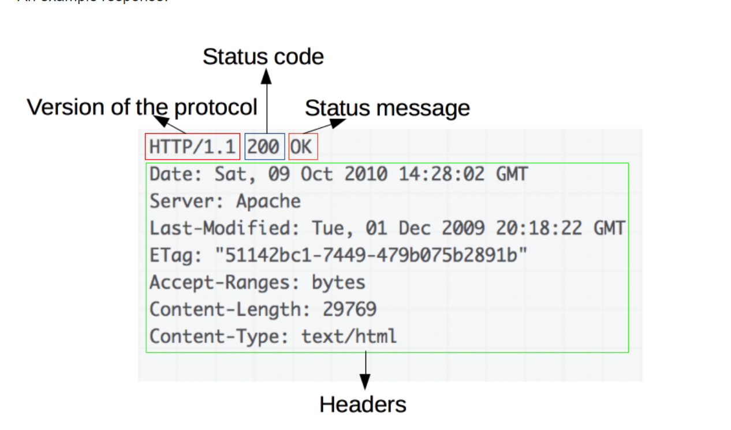
http response header

Slide 12
Peer-to-PeerNetworks
In a P2P network, the "peers" are computer systems which are connected to each other via the Inter
The only requirements for a computer to join a peer-to-peer network are an Internet connection and P2P software.
Common P2P software programs include Kazaa, Limewire, BearShare, Morpheus, and Acquisition.net
Two applications that have made a significant impact in the field: BitTorrent and the Blockchain.

